Slide 1
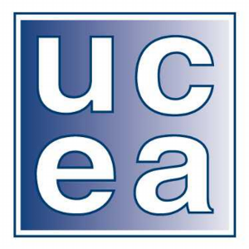
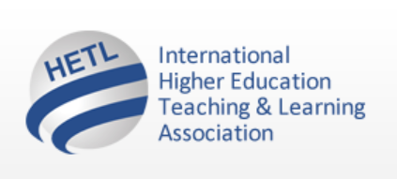
2016 UCEA International Summit: UCEA Engagement and Participation in Global Initiatives
Plenary Presentation:
Developing Global Citizenship and Inter-cultural Competencies: Examining the Work of the International Higher Education Teaching and Learning Association (HETL)
Patrick Blessinger
HETL Executive Director and Adjunct Associate Professor, St. John’s University
Sunday, November 20, 2016
Detroit, Michigan USA

Slide 2
HETL: Mission, Vision, and Values
The International Higher Education Teaching and Learning Association (HETL) is an independent, nonpartisan, nonsectarian, non-governmental, not-for-profit organization open to all educators from all nationalities, all institutional types, and all functions, levels, and disciplines within the global educational community.
The shared vision of HETL is to advance the scholarship and practice of teaching and learning in higher education.
The shared mission of HETL is to develop a global community of higher education professionals.
The shared values of HETL include integrity-ethics, collegiality-collaboration, and inclusion-diversity.

Slide 3
HETL Focus Areas
HETL is an organization that advances the scholarship and practice of teaching and learning in higher education by focusing on four core areas:
1) global networking and interdisciplinary collaboration,
2) research, innovation, and academic publishing,
3) higher education development and capacity building, and
4) human rights and social justice.

Slide 4
HETL Aims
To achieve its mission and vision and foster its core values, HETL aims, among other things, to:
foster international cooperation, understanding, and inclusion
foster global networking and interdisciplinary collaboration
provide global leadership on critical issues impacting higher education
lifelong education as a basic human right
foster the application of democratic principles worldwide
foster equality and equity in social and economic matters

Slide 5
HETL Research and Publications
The HETL Journal of Applied Research in Higher Education, the International HETL Review, and the Journal of Meaning-Centered Education disseminate current knowledge and research on teaching and learning by publishing peer-reviewed, scholarly, international, interdisciplinary, interprofessional articles from scholars, researchers, and education thought leaders from around the world.
HETL strives to conduct the most innovative and meaningful research and to produce the highest quality books, journals, and other forms of publishing.

Slide 6
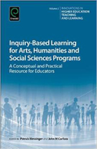
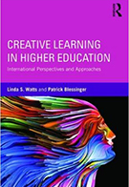
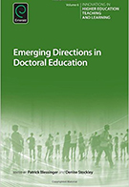
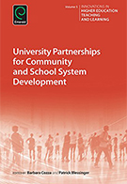
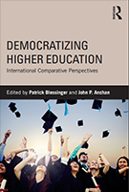
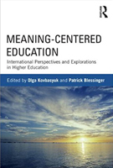
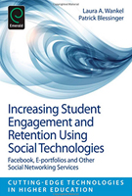
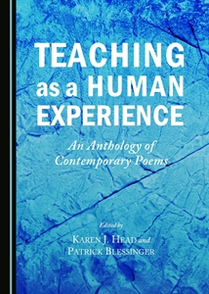
Sample of HETL Publications

Slide 7
Current Projects and Publications
Books:
Inclusive Leadership
Refugee Education
Open Education
Policy Statements:
Inclusion and Diversity
Lifelong learning as a human right

Slide 8
HETL Conferences
HETL also convenes international academic conferences that allow educators from around the world to meet face-to-face and dialogue with the world’s top academic leaders and scholars.
2017 (June) Conference: Creating Inclusion and Diversity in Higher Education. Partner: University of the West of Scotland. Proposal deadline: Dec. 31, 2016

Slide 9
HETL Collaboration
HETL has a presence on several communication platforms which helps HETL reach out to and connect with educators from around the world. HETL utilizes the “digital commons” of the internet to cultivate a global participatory culture within higher education.
Emerald HETL Education Outstanding Doctoral Research Award Program: International recognition for the best doctoral research in education
For details:
http://www.emeraldgrouppublishing.com/research/awards/hetl.htm

Slide 10
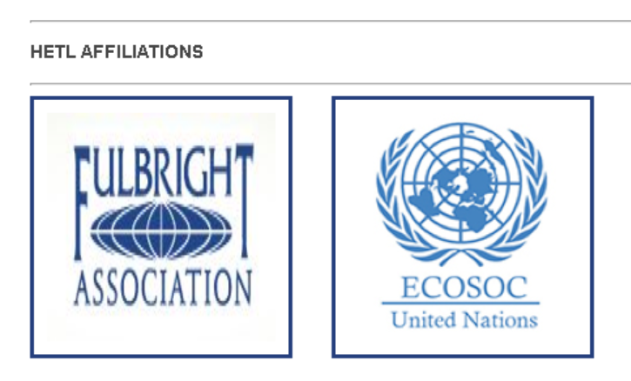
HETL Affiliations

Slide 11
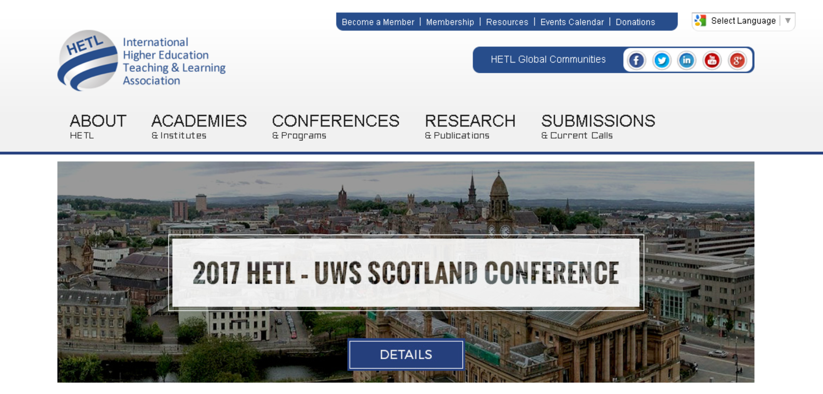
HETL Portal: hetl.org

Slide 12

UCEA – HETL Collaboration
Developing Global Citizenship and Inter-cultural Competencies
Interactive roundtable discussions to consider possible cooperative projects between UCEA and HETL, including joint research and publications.

